Slide 1
Quant GANs: Deep Generation of Financial Time Series
10 May 2022
Nathalie Bou Farhat
Giuseppe Deni
David Gauthier
ENSAE
Machine Learning For Finance

Slide 2
Table of contents
Introduction
Quant GANs: definition and architechture
Validating via stylized facts
Contribution to the domain
Pros & Cons
Conclusion
Quant GANs: Deep Generation of Financial Time Series
Machine Learning For Finance

Slide 3
Applying RL to financial datasets
Financial data on a daily scale is scarce and non-stationary. To apply deep reinforcement learning (RL) to finance training environments, for instance through market generators, need to be created as otherwise the RL agent may try to exploit spurious characteristics in the data instead of learning the underlying properties governing the data.
Potential RL applications include, but are not limited to:
• Hedging of derivatives
• Portfolio optimization
• Risk management
Quant GANs: Deep Generation of Financial Time Series
Machine Learning For Finance

Slide 4
Quant Generative adversarial networks (GANs) - Definition
Generative Adversarial Networks (GANs) are a neural network architecture family that uses two different NNs as opponents:
a generator that captures the data distribution and generates new data
the discriminator which estimates the probability that a sample came from the training data and not from the generator
The Quant GAN comprises a GAN variation which uses temporal convolutional networks (TCNs) focusing on capturing long-range dependencies
Quant GANs: Deep Generation of Financial Time Series
Machine Learning For Finance

Slide 5
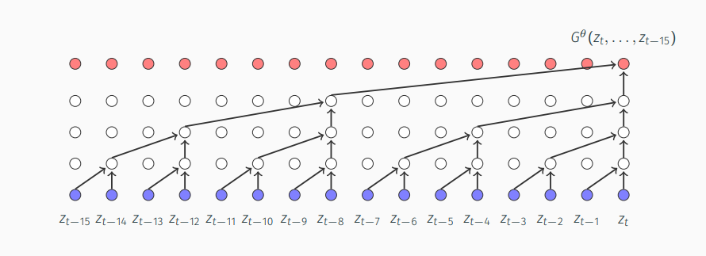
Generative adversarial networks (GANs) - Architecture
Insert text
Quant GANs: Deep Generation of Financial Time Series
Machine Learning For Finance

Slide 6
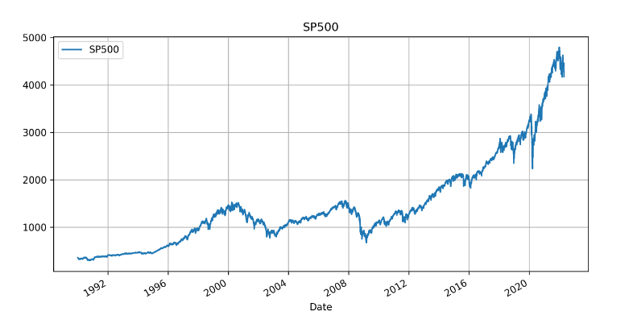
Quant GANs
With Quant GANs we aim to approximate a synthetic market generator for asset returns in an unsupervised fashion by leveraging a neural network-based discriminator as in the classic GAN setup
Quant GANs: Deep Generation of Financial Time Series
Machine Learning For Finance

Slide 7
Validating the Quant GANs performance via stylized facts
Insert text
Quant GANs: Deep Generation of Financial Time Series
Machine Learning For Finance

Slide 8

Stylized facts: kurtosis
Positive excess kurtosis: empirical distribution is peaker than the Gaussian, i.e.
$$\hat{k_{h}}=\frac{1}{T}\sum_{t=1}^{T}{{\left(\frac{X_{t}−\overline{X}}{\hat{σ\left(X\right)}}\right)}^{4}}−3$$
Insert text
Quant GANs: Deep Generation of Financial Time Series
Machine Learning For Finance

Slide 9
Stylized facts: fat tails
Insert text
Quant GANs: Deep Generation of Financial Time Series
Machine Learning For Finance

Slide 10

Stylized facts: leverage effects
Define the empirical auto-covariance function as
$$\hat{ρ_{h}(k)}=\frac{1}{T−k}\sum_{t=1}^{T−k}{\left(X_{t}−\overline{X}\right)\left(X_{t+k}−\overline{X}\right)}$$
Insert text
Quant GANs: Deep Generation of Financial Time Series
Machine Learning For Finance

Slide 11
Contribution to the domain
Insert text
Quant GANs: Deep Generation of Financial Time Series
Machine Learning For Finance

Slide 12
Pros of Quant GANs
TCNs are able to capture long-range dependencies effectively (differently from standard econometric approaches)
Absence of exponentially vanishing and exploding gradients through time (compared to RNN)
TCNs accurately model the sharp drop in the ACF of the serial returns
GANs are capable to handle financial series stylized facts
GAN is assumption free by construction, being totally non-parametric
GAN has no backpropagation through time (vs RNN/LSTM)
Quant GANs: Deep Generation of Financial Time Series
Machine Learning For Finance

Slide 13
Cons of Quant GANs
GANs are unconditional generators and, as such, no initial conditions can be inferred
GANs are stochastic generators and as such they have no a specified criterion when to stop training (there is no objective loss function)
Hard to establish “correct” and objective evaluation of GAN generator models
The construction of the generator causes synthetic log-returns to be independent after a finite number of lags
Like other NNs, GAN is neither parsimonious nor interpretable
Quant GANs: Deep Generation of Financial Time Series
Machine Learning For Finance

Slide 14
Conclusion
Insert text
Quant GANs: Deep Generation of Financial Time Series
Machine Learning For Finance

